Slide 1
Lab 5: Phylogenetics I – Tree Thinking and Maximum Parsimony
Slides stolen from Steve Mussmann’s 2016 ConsGen and Jeff Silberman’s Molecular Phylogenetics course

Slide 2
Today: Phylogenetics I
Impossible to cover all of phylogenetics in 3 lab sessions
We will gloss over much material
Focus on practical aspects and understanding phylogenies
Lots of terms, do your best, I believe in you

Slide 3
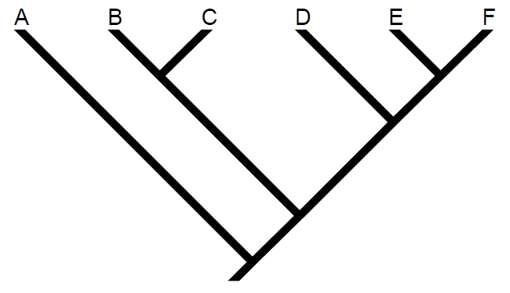
Basics of Trees
Terminal node (leaf)
Clade
Branch (edge)
Internal node (hypothetical ancestor)
Root

Slide 4
Terminal nodes: Represent organisms (e.g. species) or DNA sequences for which we have data
Terminal node (leaf)
Clade
Branch (edge)
Internal node (hypothetical ancestor)
Root

Slide 5
Internal nodes: Hypothetical ancestors; terminal nodes are descended from these ancestors
Terminal node (leaf)
Clade
Branch (edge)
Internal node (hypothetical ancestor)
Root

Slide 6
Branches: Connect nodes and represent paths of shared ancestry
Terminal node (leaf)
Clade
Branch (edge)
Internal node (hypothetical ancestor)
Root

Slide 7
Root: Common ancestor of all nodes in the tree
Terminal node (leaf)
Clade
Branch (edge)
Internal node (hypothetical ancestor)
Root

Slide 8
Clade: Group including an ancestral node and all of its descendants (=monophyly)
Terminal node (leaf)
Clade
Branch (edge)
Internal node (hypothetical ancestor)
Root

Slide 9
IMPORTANT: Rotating internal nodes does not change the tree
A
B
C
D
E

Slide 10
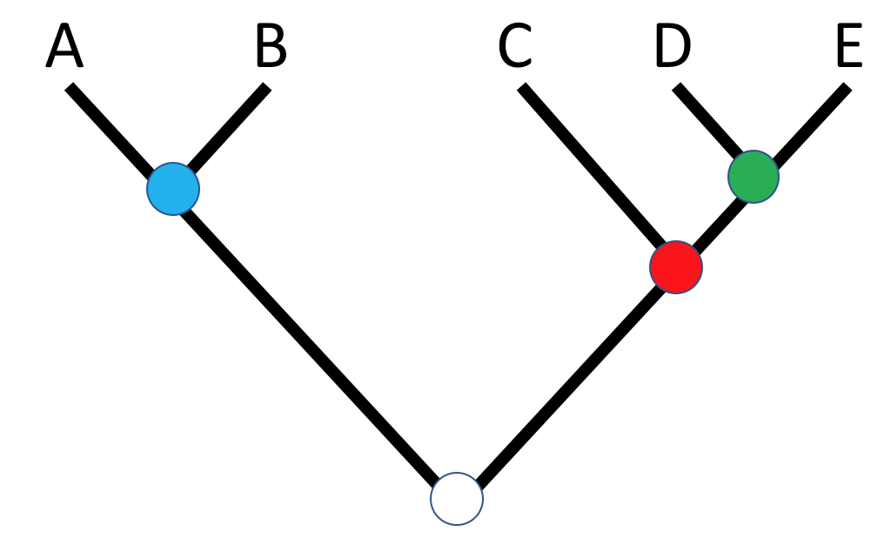

These trees are equivalent

Slide 11
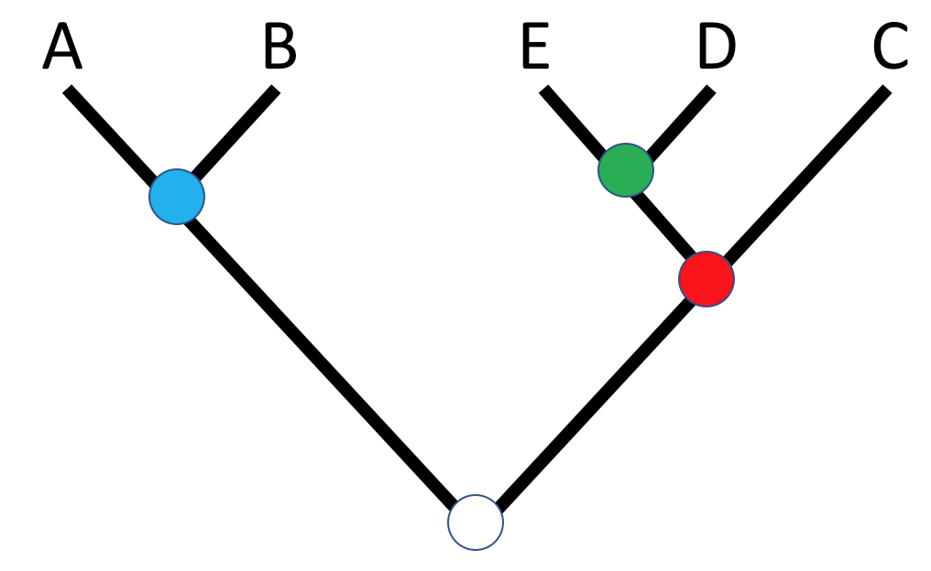
These trees are also equivalent

Slide 12
What does this mean? Trees are read from root to terminal node, NOT right to left
A
B
C
D
E
Up and down means everything
Left and right means nothing

Slide 13
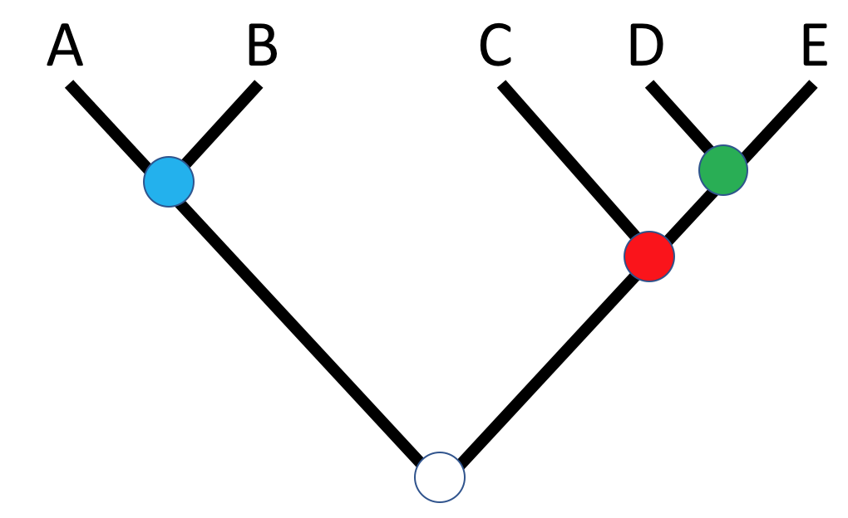
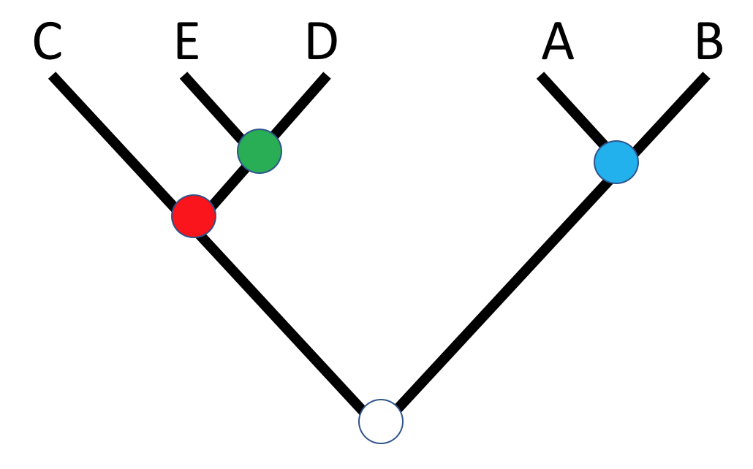
Trees illustrate patterns of shared ancestry
A and B share a recent common ancestor (=sister taxa)
D and E share a recent common ancestor (=sister taxa)
C sister to D+E
All share a common ancestor at the root

Slide 14
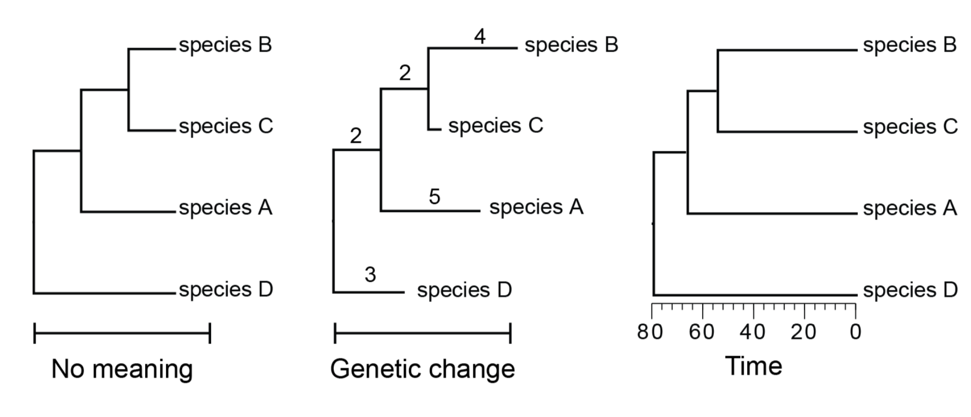
Length of branches can show different information
Cladogram
Phylogram
Ultrametric
ALL show the same relationships, or branching orders, among taxa

Slide 15
Trees can also vary in level of resolution
Unresolved
Partially Resolved
Resolved
“Polytomy”
“Fully bifurcating”
“Hard” polytomy: Unresolvable, due to simultaneous divergence
“Soft” polytomy: Resolvable, due to uncertainty in data

Slide 16
Rooted vs unrooted trees
Rooted trees have “direction” corresponding to evolutionary time
Unrooted trees lack direction, prohibiting inference of ancestor-descendant relationships

Slide 17
Why is rooting useful?
Rooting the tree provides context to determine ancestral vs derived character states relative to the outgroup
“Ingroup”
“Outgroup”

Slide 18
“Ancestral” and “Derived” are Relative
The red trait is ancestral to both the green and blue traits.
The green trait derived relative to the red trait, but also ancestral to the blue trait

Slide 19
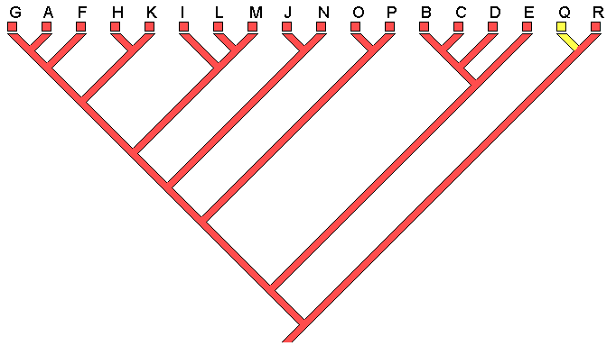
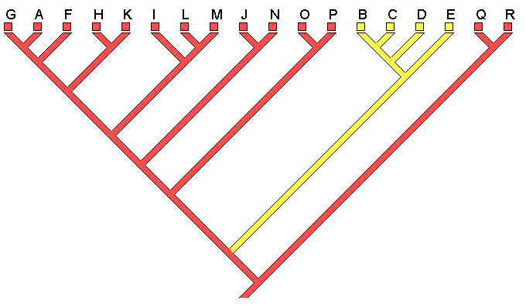
_{Apomorphies: Derived States}
“Autapomorphy”
Derived state appearing in only one taxon
“Synapomorphy”
Shared derived state
Informative of shared ancestry

Slide 20
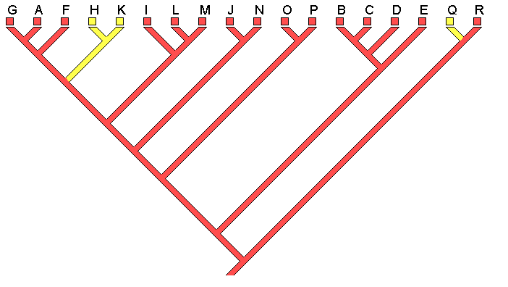
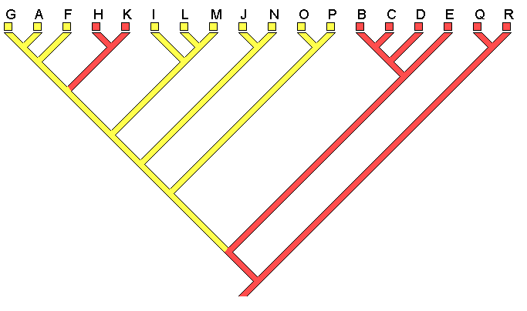
Homoplasy: Shared states due to independent origin
Convergence
State reversal
Shared states due to independent events → obscures ability to infer phylogeny
Need to evaluate many characters to compensate

Slide 21
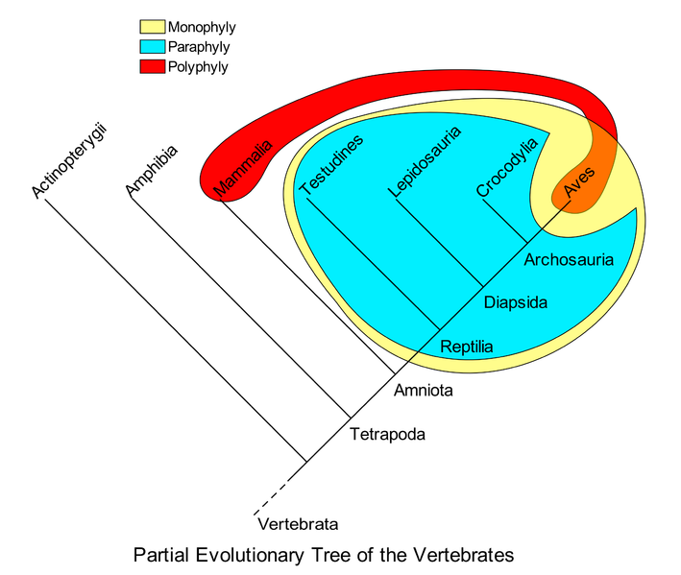
More Terminology: Describing Groups
Monophyly = group includes MRCS and all descendants
Paraphyly = group includes MRCA but not all of its descendants
Polyphyly = group does not include the MRCA of its members

Slide 22
Tree building methods
Distance
Summarizes all changes using a distance-matrix
Assumes smaller distance = closer relationship
Find tree that best fits observed summarized distances
Character-based
Evaluate individual character-state changes and find tree that best fits observed states
E.g. Maximum Parsimony, Maximum Likelihood

Slide 23
Tree building methods
Maximum parsimony (today)
Assumes tree (phylogenetic hypothesis) with least character state changes is best solution
Is a character-based method, meaning we consider individual character-state changes rather than a summary (e.g. total ‘distance’)
Principle of Parsimony: Simplest explanation to solve problem; simple = most probable
“Maximum Parsimony” = model selection by maximizing simplicity

Slide 24
Maximum Parsimony
Basic idea: Minimizing steps
Evolutionary changes (steps): One nucleotide to another
One amino acid to another
Basic implicit assumptions:
Change is rare
Synapomorphies define clades
Characters are independent
Homoplasy should be rare (And causes problems when it isn’t)
Best tree = fewest changes

Slide 25
Finding the “Most Parsimonious Reconstruction” (MPR)
Build a starting tree
Calculate changes necessary for each nucleotide position
Sum these up to get the ‘tree length’ for that tree
Permute tree → Keep permuting to minimize tree length

Slide 26
Parsimony example – 4 taxa
Alignment
AG…
AA…
GG…
GC…

Slide 27
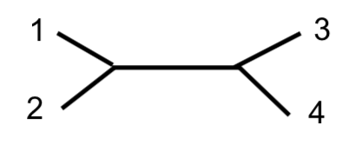
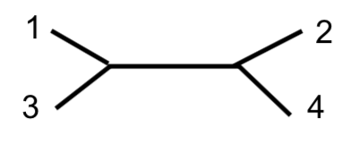
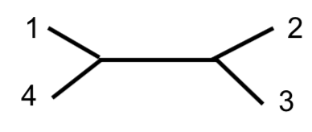
Parsimony example – 4 taxa
3 possible trees
Alignment
AG…
AA…
GG…
GC…
For each tree, calculate number of changes required to explain… One site at a time

Slide 28
Parsimony example – 4 taxa
3 possible trees
Alignment
AG…
AA…
GG…
GC…
For each tree, calculate number of changes required to explain… One site at a time

Slide 29
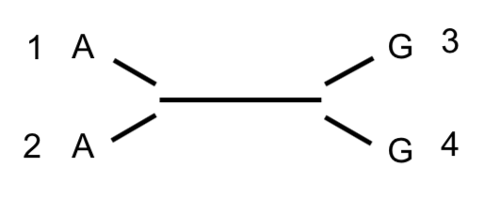
Parsimony example – 4 taxa
State changes for site 1
3 possible trees
Alignment
AG…
AA…
GG…
GC…
For each tree, calculate number of changes required to explain… One site at a time

Slide 30
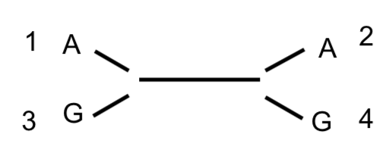
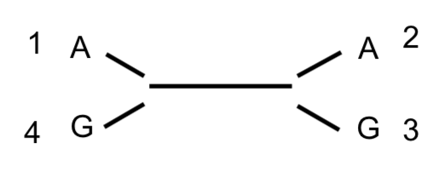
Parsimony example – 4 taxa
State changes for site 1
3 possible trees
Alignment
AG…
AA…
GG…
GC…
For each tree, calculate number of changes required to explain… One site at a time

Slide 31
Parsimony example – 4 taxa
3 possible trees
Alignment
AG…
AA…
GG…
GC…
Scoring the trees… Find MPR for each site in each tree

Slide 32
Parsimony example – 4 taxa
3 possible trees
Alignment
AG…
AA…
GG…
GC…
Finding MPR for Tree #1, at site #1…

Slide 33
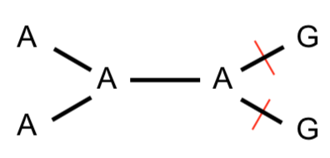
Parsimony example – 4 taxa
MPR for tree 1
3 possible trees
Alignment
AG…
AA…
GG…
GC…
Finding MPR for Tree #1, at site #1…

Slide 34
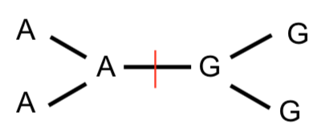
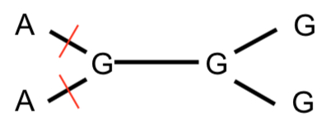
Parsimony example – 4 taxa
MPR for tree 1
3 possible trees
Alignment
AG…
AA…
GG…
GC…
Finding MPR for Tree #1, at site #1…
Etc…

Slide 35
Parsimony example – 4 taxa
MPR for tree 1
3 possible trees
Alignment
AG…
2 changes
AA…
MPR for site 1
GG…
GC…
1 change
2 changes
Finding MPR for Tree #1, at site #1…

Slide 36
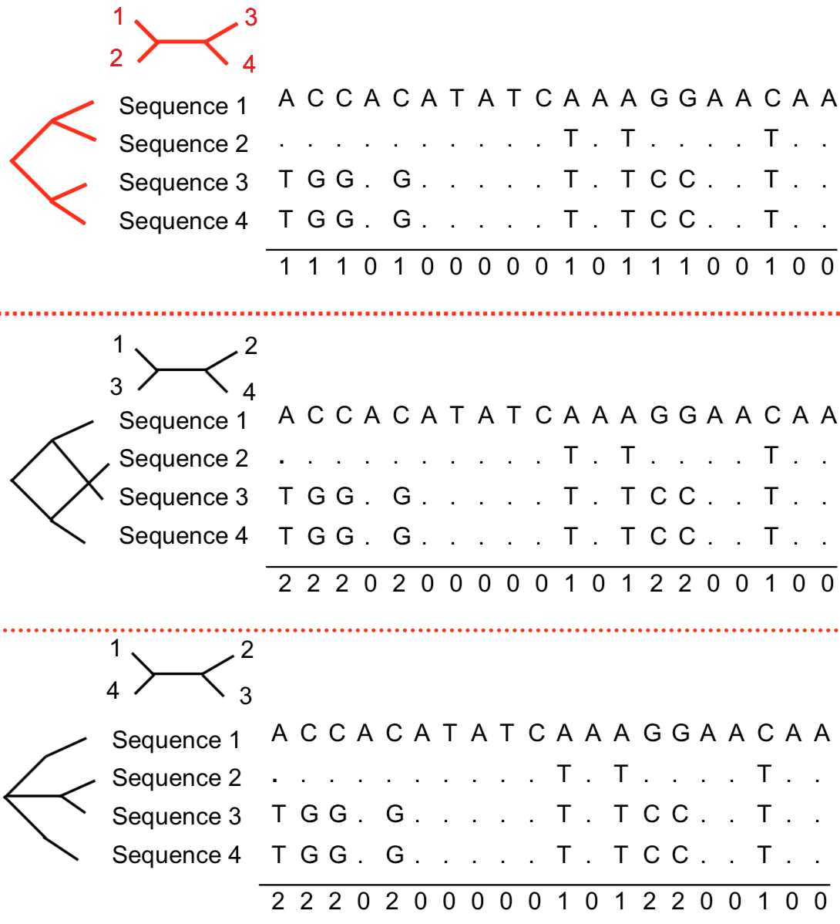
Sum up changes needed for each tree = tree length

Slide 37
Sum up changes needed for each tree = tree length
TL = 9
TL = 15
TL = 15

Slide 38
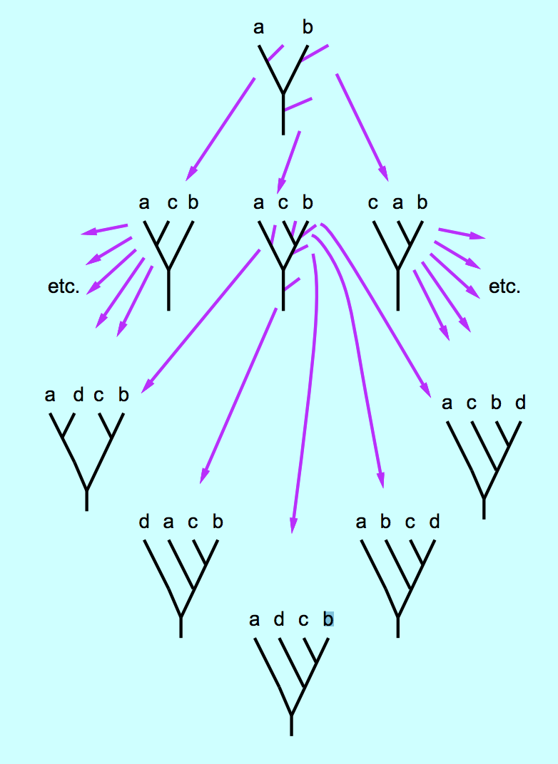
Searching “tree space”
Sample tree → evaluate
Easy for 4 taxa
Grows very quickly
Fig from Joe Felsenstein Genome 541 course, U Washington

Slide 39
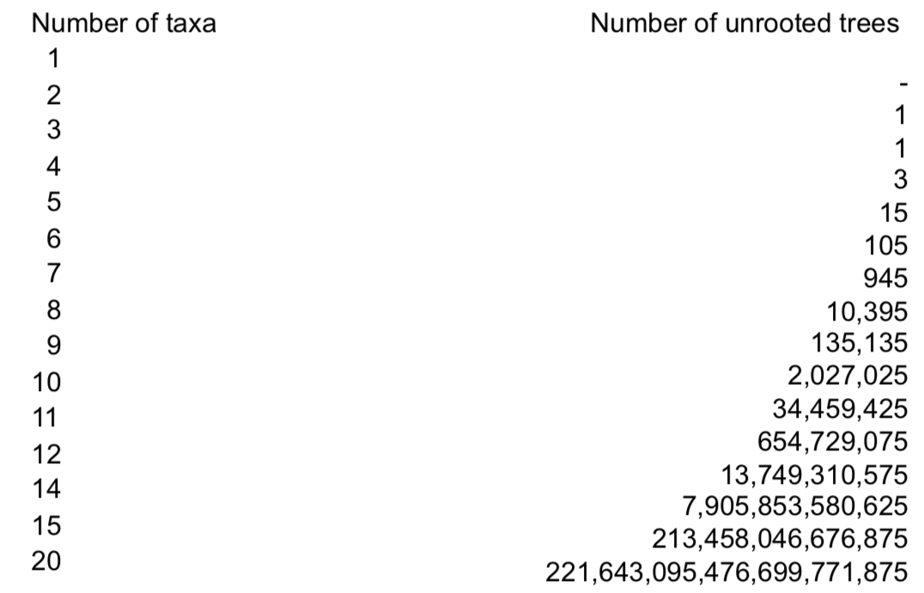
Searching “tree space”
Exhaustive search
Easy for 4 taxa
(2n-5)!! = number unrooted trees for n taxa

Slide 40
Searching “tree space”
Heuristic search
Almost always necessary in practice
Process:
Make a tree
Permute tree (swap branches, etc)
Calculate tree length → Is it better?
YES: Discard old tree and permute new
NO: Discard new tree

Slide 41
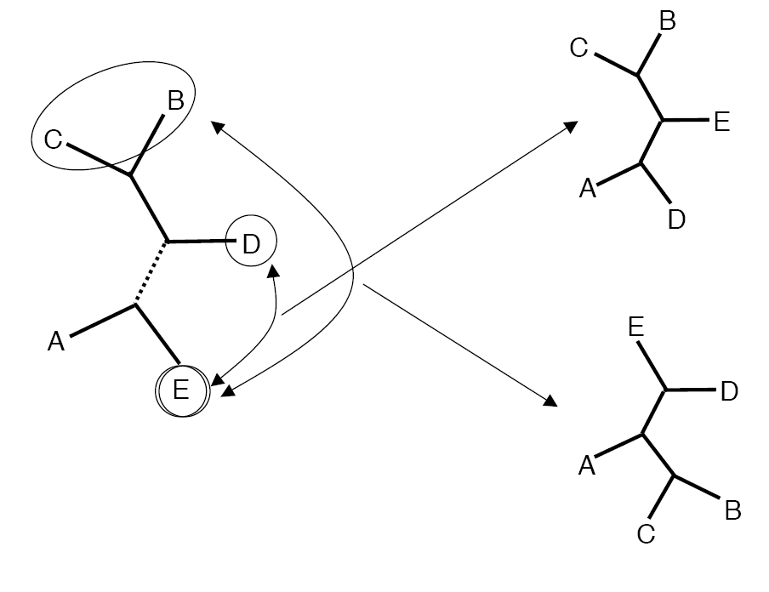
Branch swapping: NNI
Nearest-Neighbor Interchange
Swaps positions of neighboring taxa
Small, local changes

Slide 42
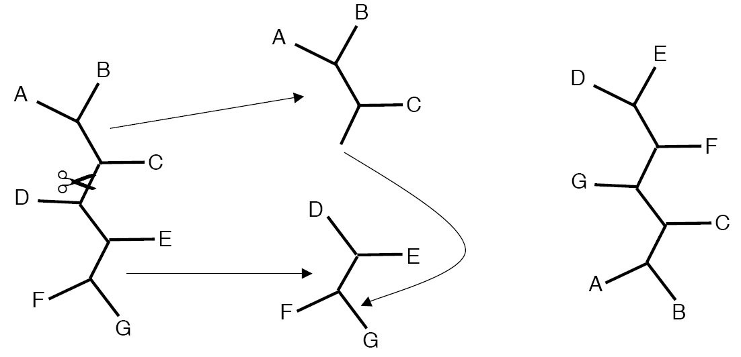
Branch swapping: SPR
Subtree Pruning and Re-rooting
Cut tree and graft subtree onto another branch

Slide 43
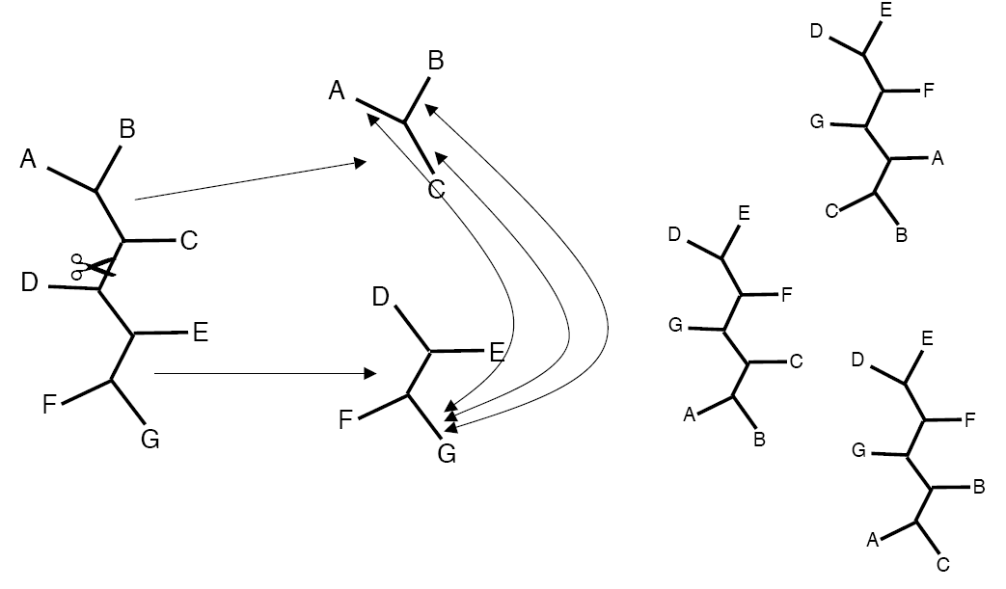
Branch swapping: TBR
Tree Bisection and Reconnection
Cut tree and test all combinations of subtrees
More rigorous than SPR

Slide 44
Searching “tree space”
Tree 1
TL=58

Slide 45
Searching “tree space”
swap
Tree 1
TL=58

Slide 46
Searching “tree space”
Tree 2
swap
TL=97
Tree 1
TL=58

Slide 47
Searching “tree space”
Tree 2
swap
TL=97
Tree 1
Decision tree of “bad swaps” terminated
TL=58

Slide 48
Searching “tree space”
Tree 2
swap
TL=97
Tree 1
TL=58
swap
Tree 3
TL=57

Slide 49
Searching “tree space”
Tree 2
swap
TL=97
Tree 1
TL=58
swap
“Good swap” results in new “best tree”
Tree 3
TL=57

Slide 50
Searching “tree space”
Tree 2
Tree 2
TL=66
swap
TL=97
Tree 6
TL=112
Tree 1
TL=58
swap
Tree 3
Tree 5
TL=57
TL=64
Tree12
Tree10
Tree 8
TL=57
TL=55
TL=59
Tree 7
Tree 6
Tree11
TL=57
Tree 7
Tree 9
TL=52
TL=68
TL=52
TL=48
*NOTE: There may be multiple “best” trees!!

Slide 51
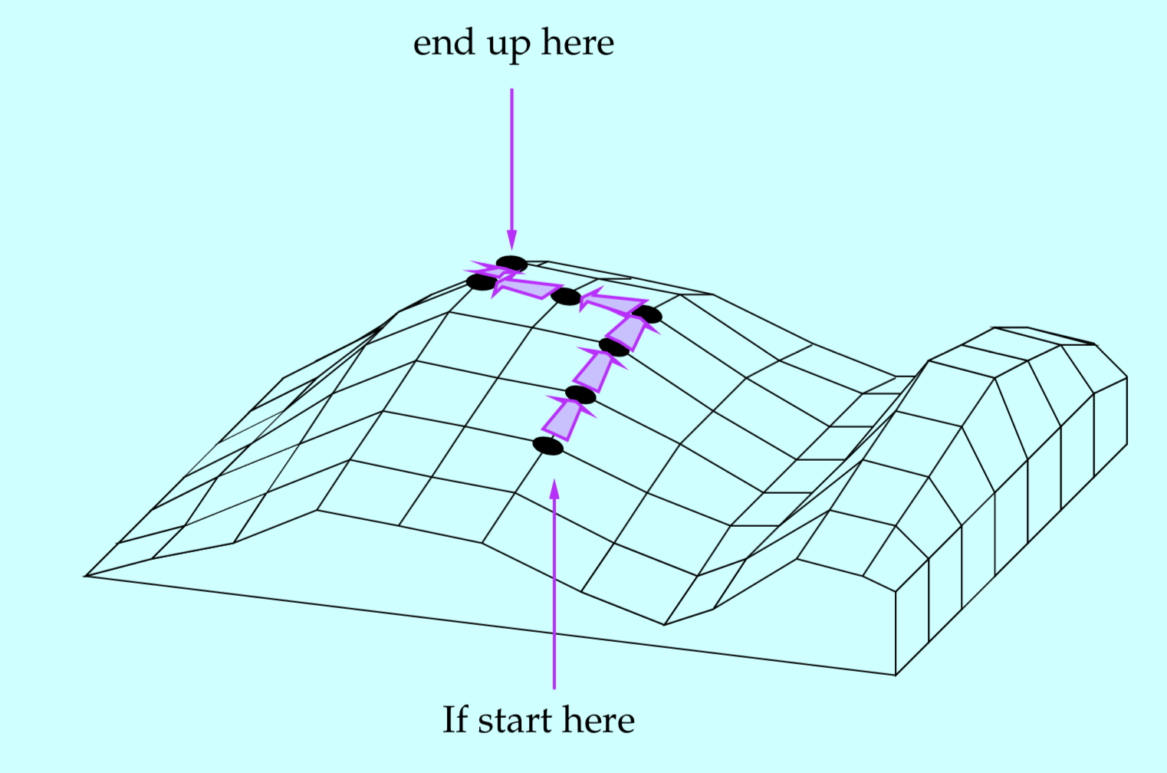

Slide 52
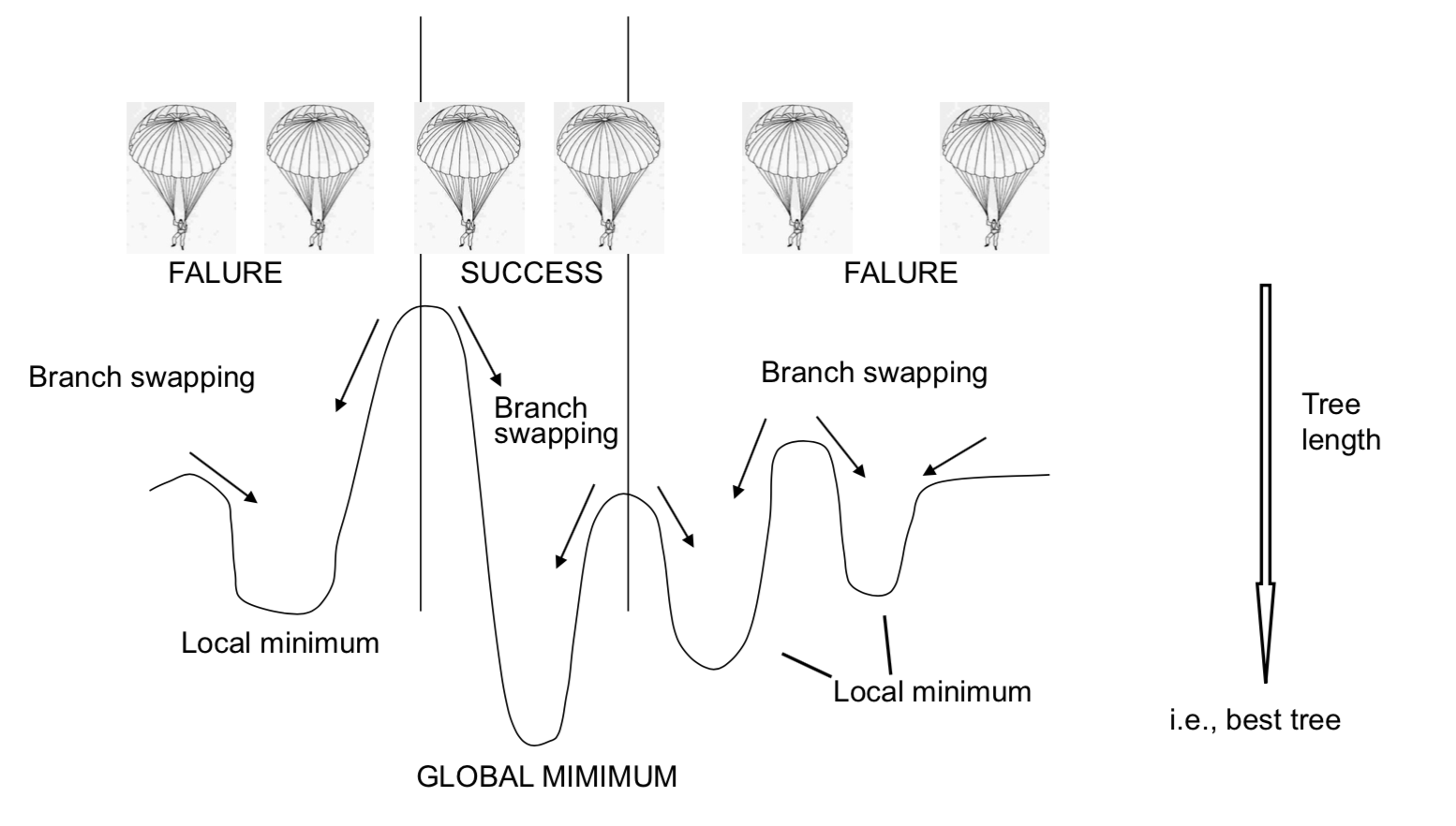
Tree space as a landscape

Slide 53
Tree space as a landscape
Branch swapping to traverse hills

Slide 54
Tree space as a landscape
Success in finding “global optimum” depends on where you start

Slide 55
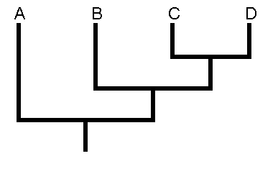
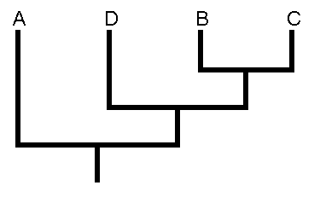
Multiple Equally Parsimonious Trees
Under Maximum Parsimony, one character matrix can lead to multiple equally parsimonious trees
Original Character Matrix
Equally Parsimonious Trees

Slide 56
Multiple Equally Parsimonious Trees
Equally Parsimonious Trees
50% Majority Rule Consensus Tree
75
100
100

Slide 57
Exploring tree space: In practice
Use replicate heuristic searches
TBR branch-swapping or most rigorous option available
Lots and lots of random starting trees

Slide 58
Evaluating trees
Given a ”best tree”, how to evaluate support?
Non-parametric bootstrapping
Process:
Randomly resample (with replacement) the columns of your character matrix to make a pseudoreplicate data set
Build a new tree from each pseudoreplicate
Repeat 100 to 1000 times

Slide 59
Bootstrapping
Bootstrap Trees
Pseudoreplicate Matrices
Original Character Matrix

Slide 60
Bootstrapping Values
Bootstrap Trees
67
100
100
Values representing percentage of bootstrap trees agreeing with “best tree” are then used to annotate nodes in tree

Slide 61
Bootstrap Values
Represent the percent of bootstrap trees in which a certain node or branch was found to exist.
e.g., “Node has 75% bootstrap support.”
Values under ~70-80 are generally considered “poor”
67
67
100
These values are derived from pseudoreplicates (not the original data matrix)

Slide 62
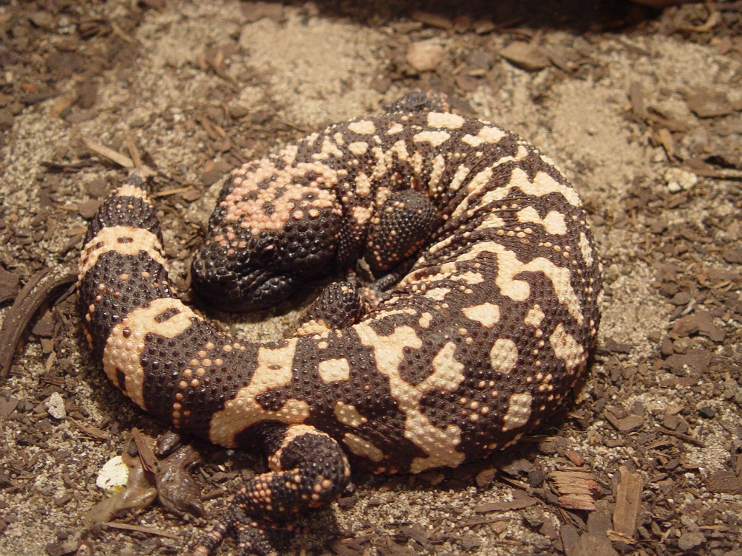
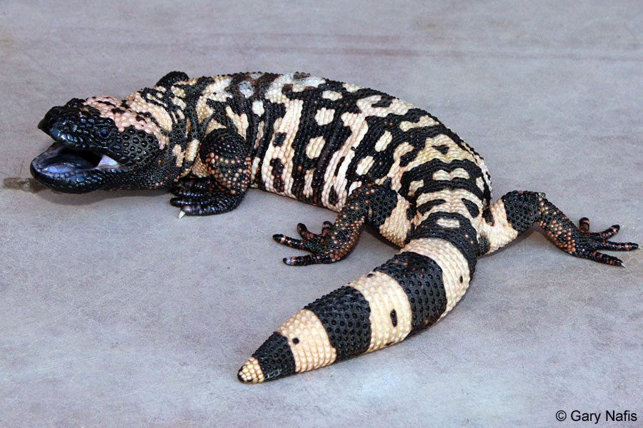
Today’s Lab
Data file contains a variety of lizards, snakes, and tuatara
Data borrowed from Douglas et al. 2010:
“Conservation phylogenetics of helodermatid lizards using multiple molecular markers and a supertree approach”

Slide 63
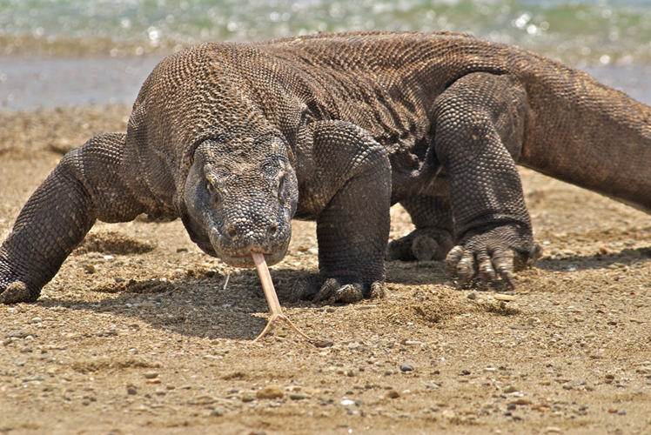
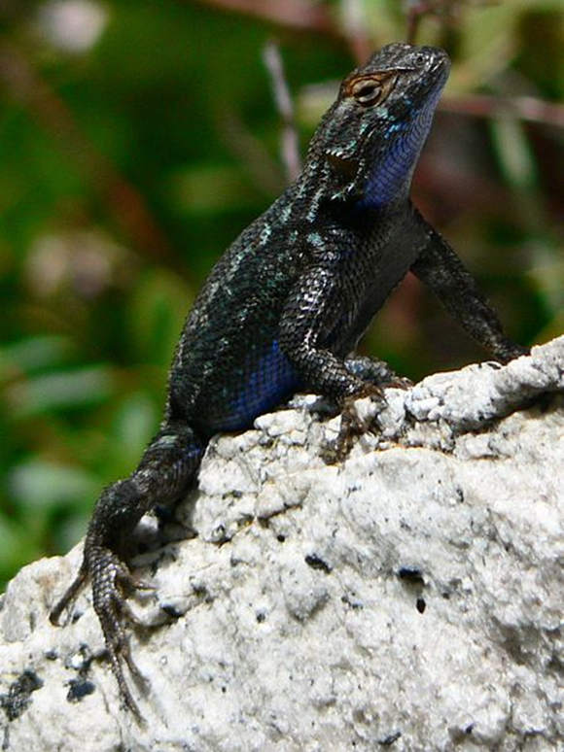
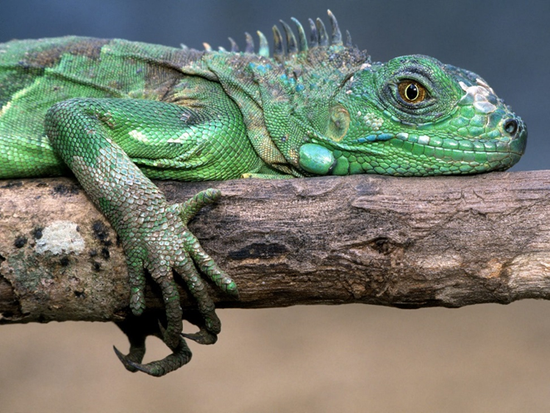
Outgroups - lizards

Slide 64
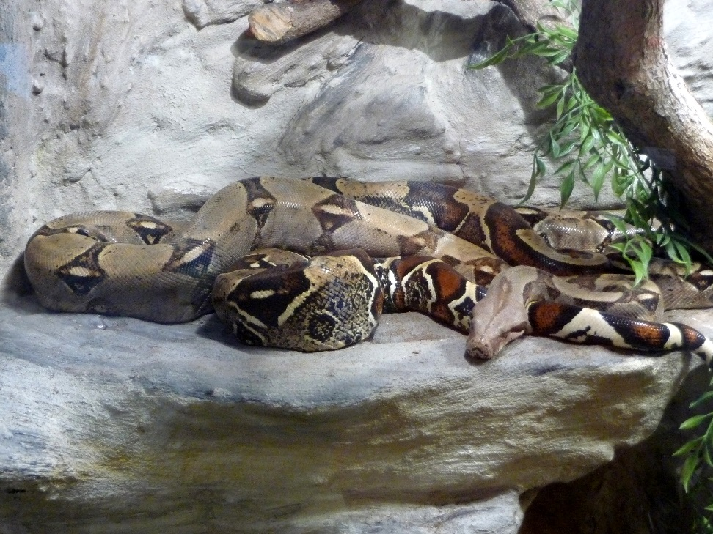
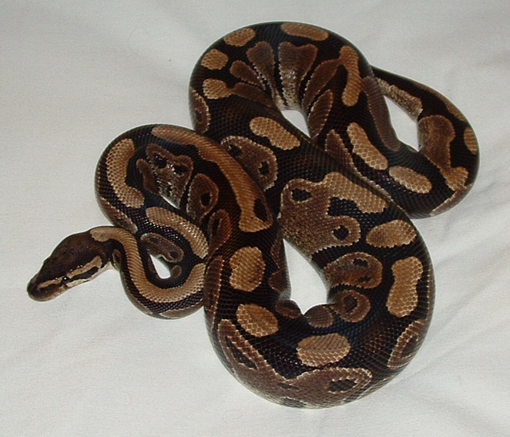
Outgroups: Snakes
Order: Squamata
Suborder: Serpentes

Slide 65
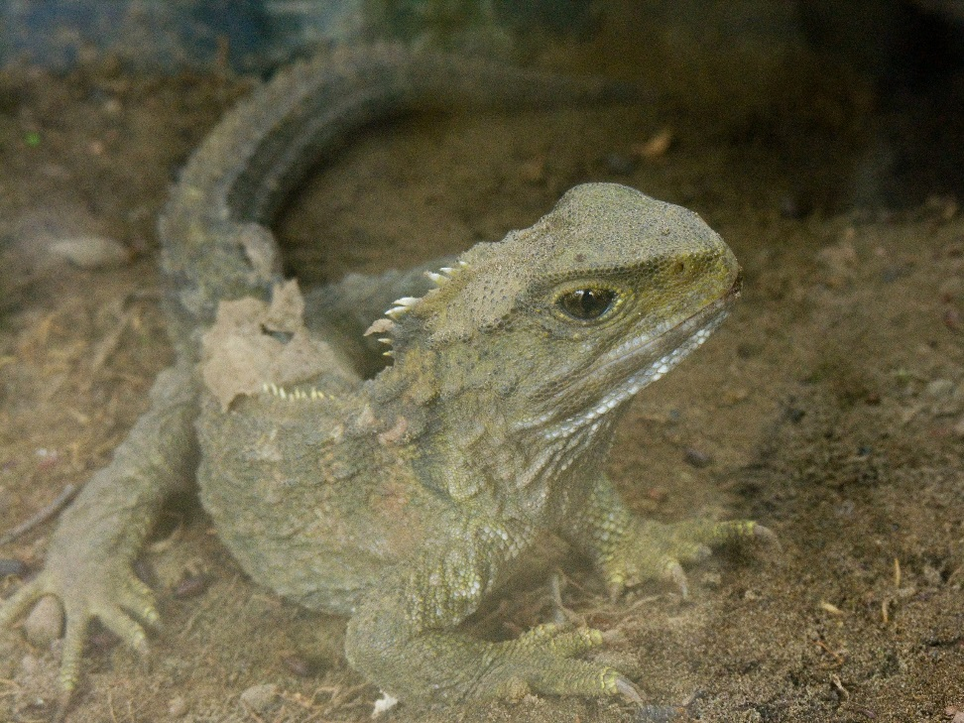
Sphenodon punctatus
Order: Rhynchocephalia
Family: Sphenodontidae
Only members of their order
Endemic to New Zealand

Slide 66
Update class materials
Via GitHub:
cd ~/Desktop/<user>/ConsGen2018
git pull
Or via Blackboard:
Download lab5.tar.gz
tar –xvzf lab5.tar.gz

